Slide 1


Virtual Gardener Leveraging IoT and Bluetooth for Real-Time Plant Health Insights Mobile application development project work in coordination with Assimilatus Company
Group Members:
Ahmed Saber Elsayed Radwan
Abshir Muhumed Abdi
Jwan Mardini
Lakshmi Vishal Hayagrivan
Mohamad Alloush
Solomon Sugamo
Notes:
Solomon

Slide 2
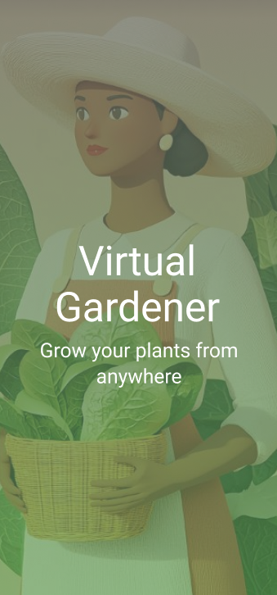
Introducing Virtual Gardener App
Overview: Introducing the need for efficient, real-time monitoring of plant health using IoT and Android mobile technology.
Problem Statement: How can continuous monitoring improve plant growth, reduce human intervention, and prevent issues before they impact the plant's health?
Notes:
Ahmed

Slide 3
Objective:
To provide users with accessible, real-time data on their plants' health parameters (soil moisture, temperature, humidity, and location) and send real time notifications when the conditions gets tougher to inform timely decisions.
Notes:
Solomon

Slide 4
Technologies Used
Software
Programming Language: Kotlin
Android Development Frameworks and Libraries:
Android Jetpack (Jetpack Compose, ViewModel, LiveData), Navigation Components
Google APIs:
Google Play Services Location API, Firebase(Firebase Authentication, Firebase Firestore)
Android SDK and Build Tools: Gradle, Android SDK, Material Design Components
Networking Libraries: OkHttp, Volley, Gson
Git and GitHub
Project Structure and Design Patterns:
MVVM (Model-View-ViewModel), Modularization
Notes:
Jwan

Slide 5
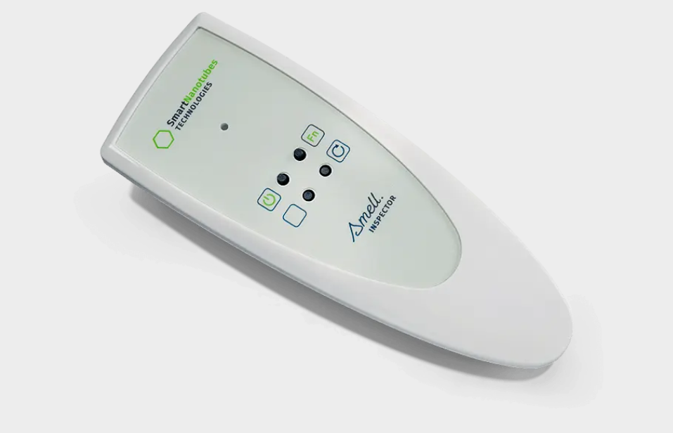
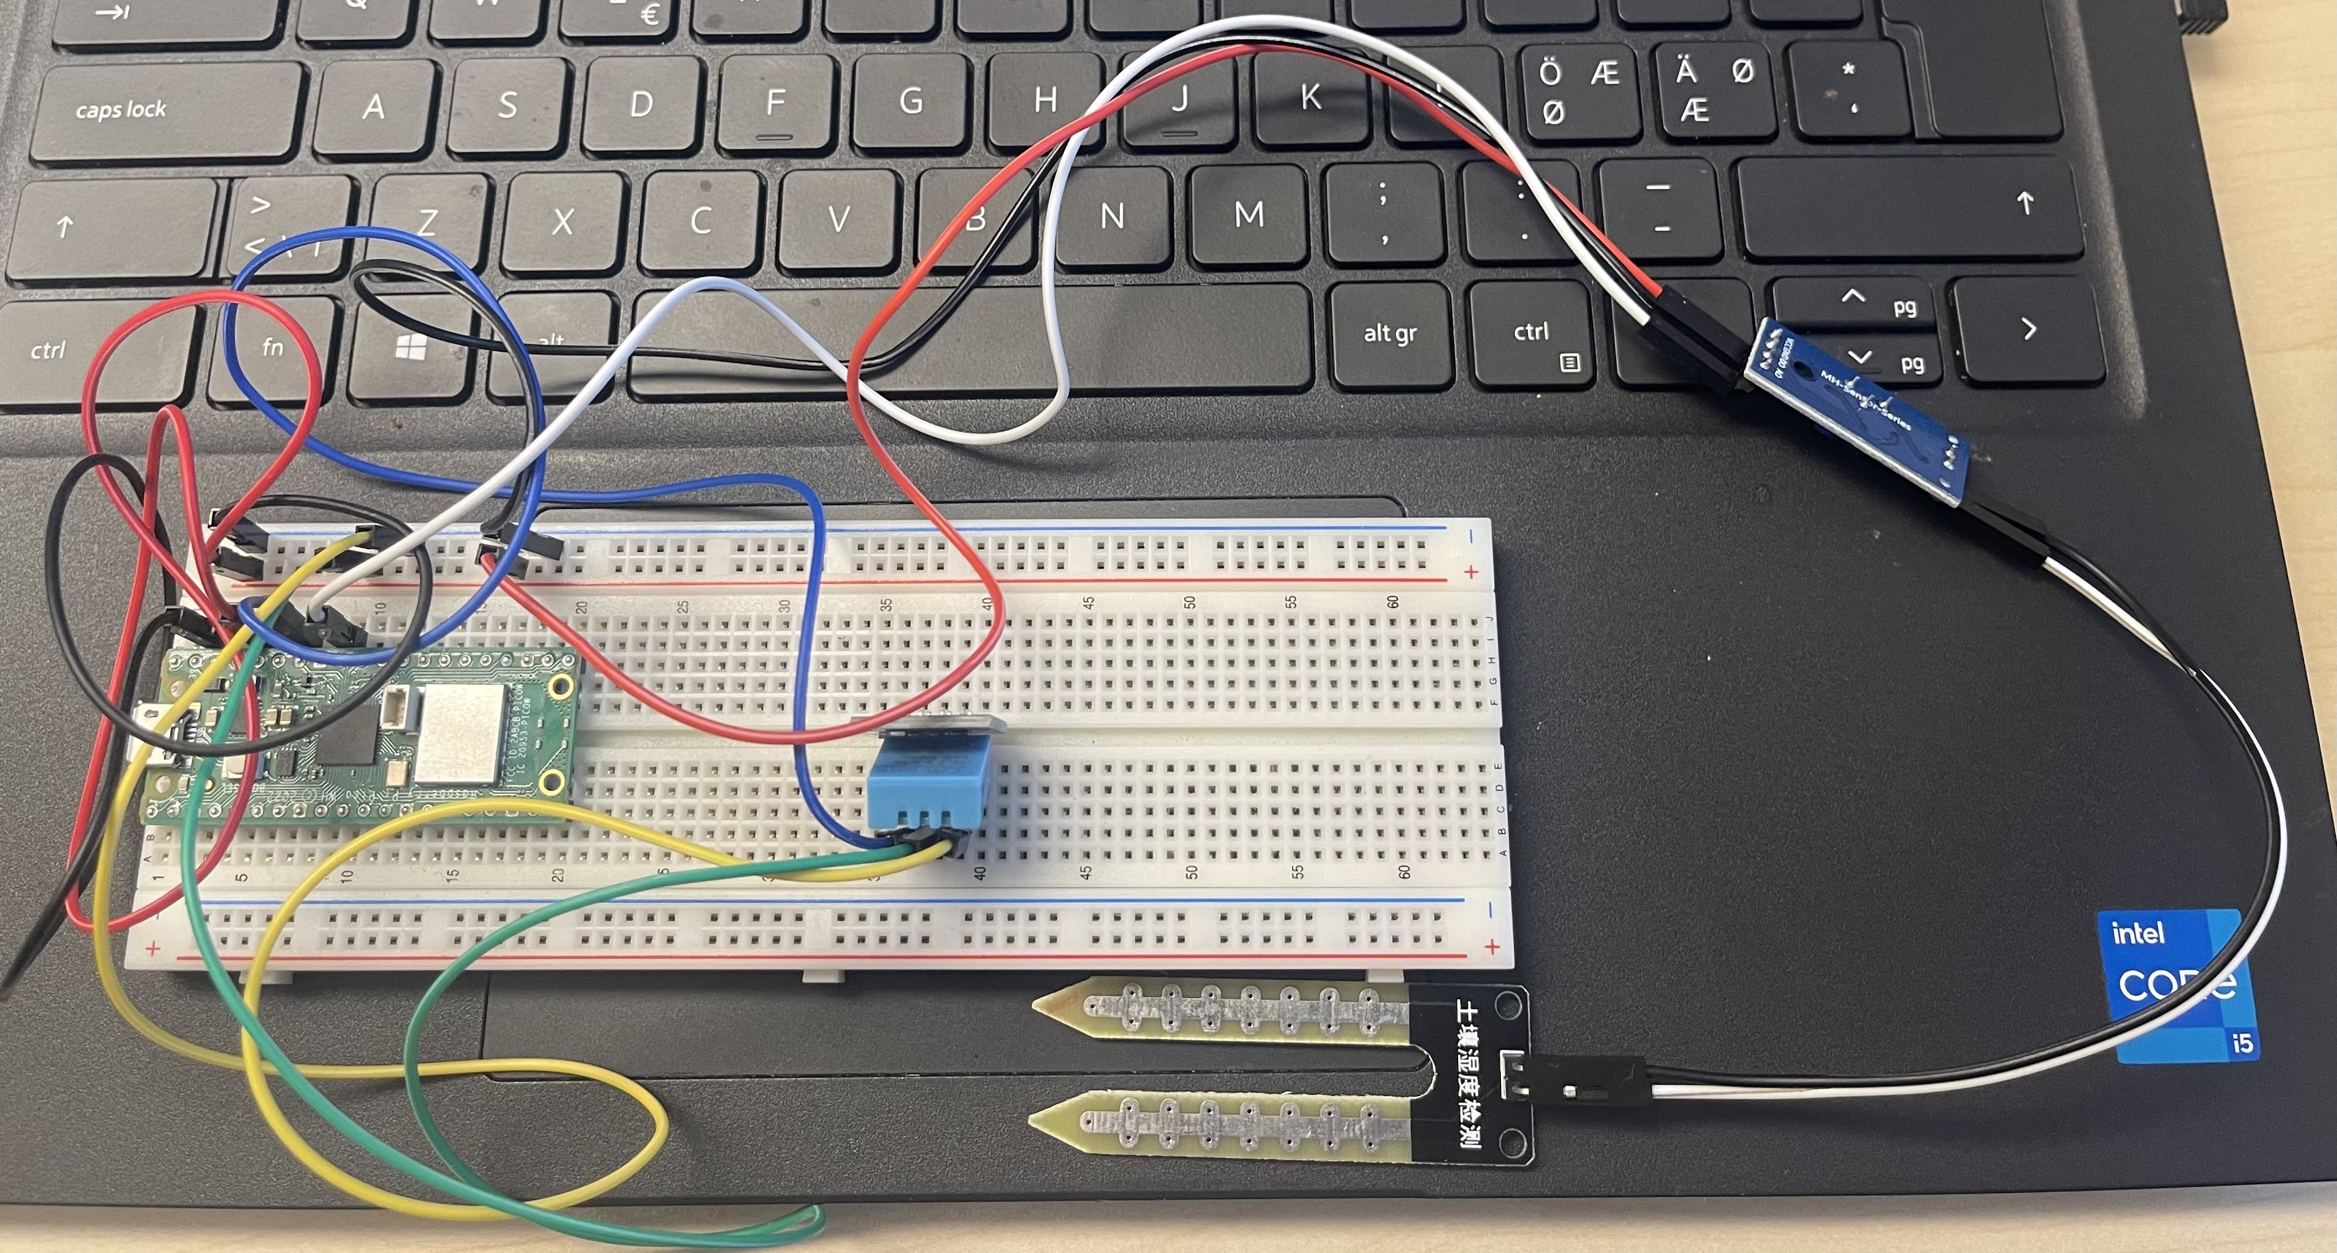
Technologies Used
Hardware
Smart Nanotubes smell inspector
Raspberry Pi Pico W
DHT11 Temperature and Humidity Sensor
Soil Moisture Sensor
Notes:
Jwan

Slide 6
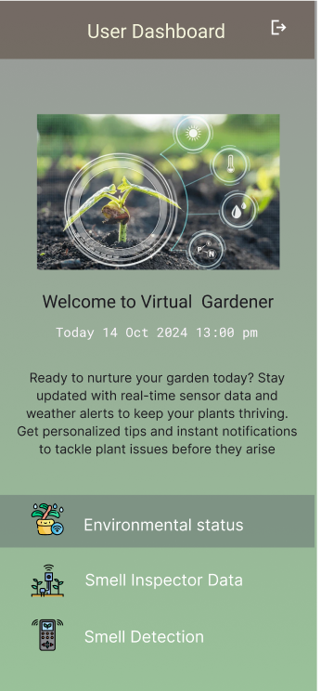
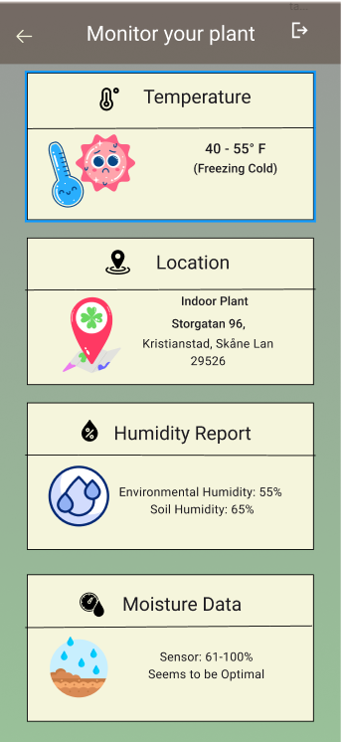
Design Overview
The interface was prototyped in Figma with a user-centered layout, following Material 3 design principles.
This ensures an intuitive and responsive experience, offering real-time plant health insights with seamless data integration.
Notes:
Lakshmi

Slide 7
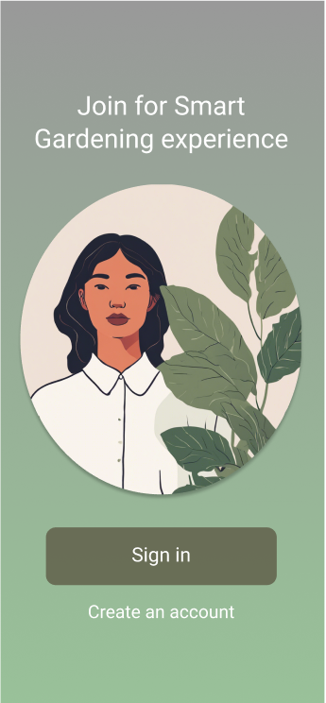
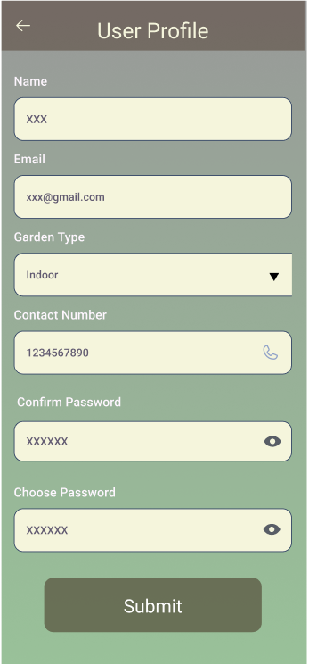
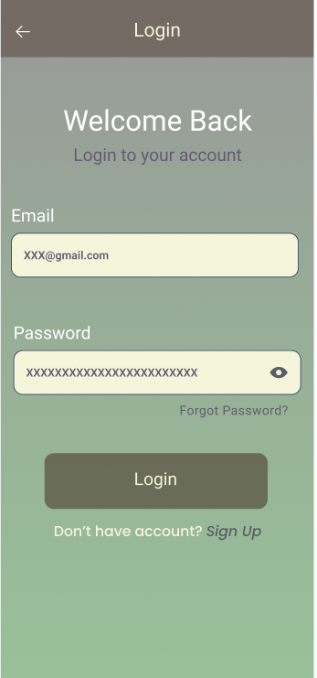
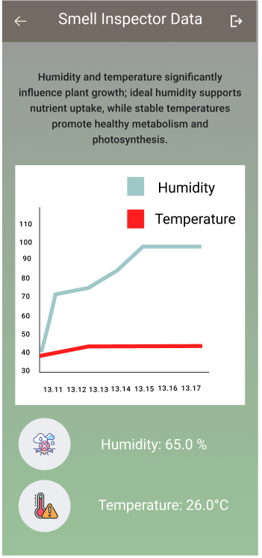
Notes:
Lakshmi

Slide 8
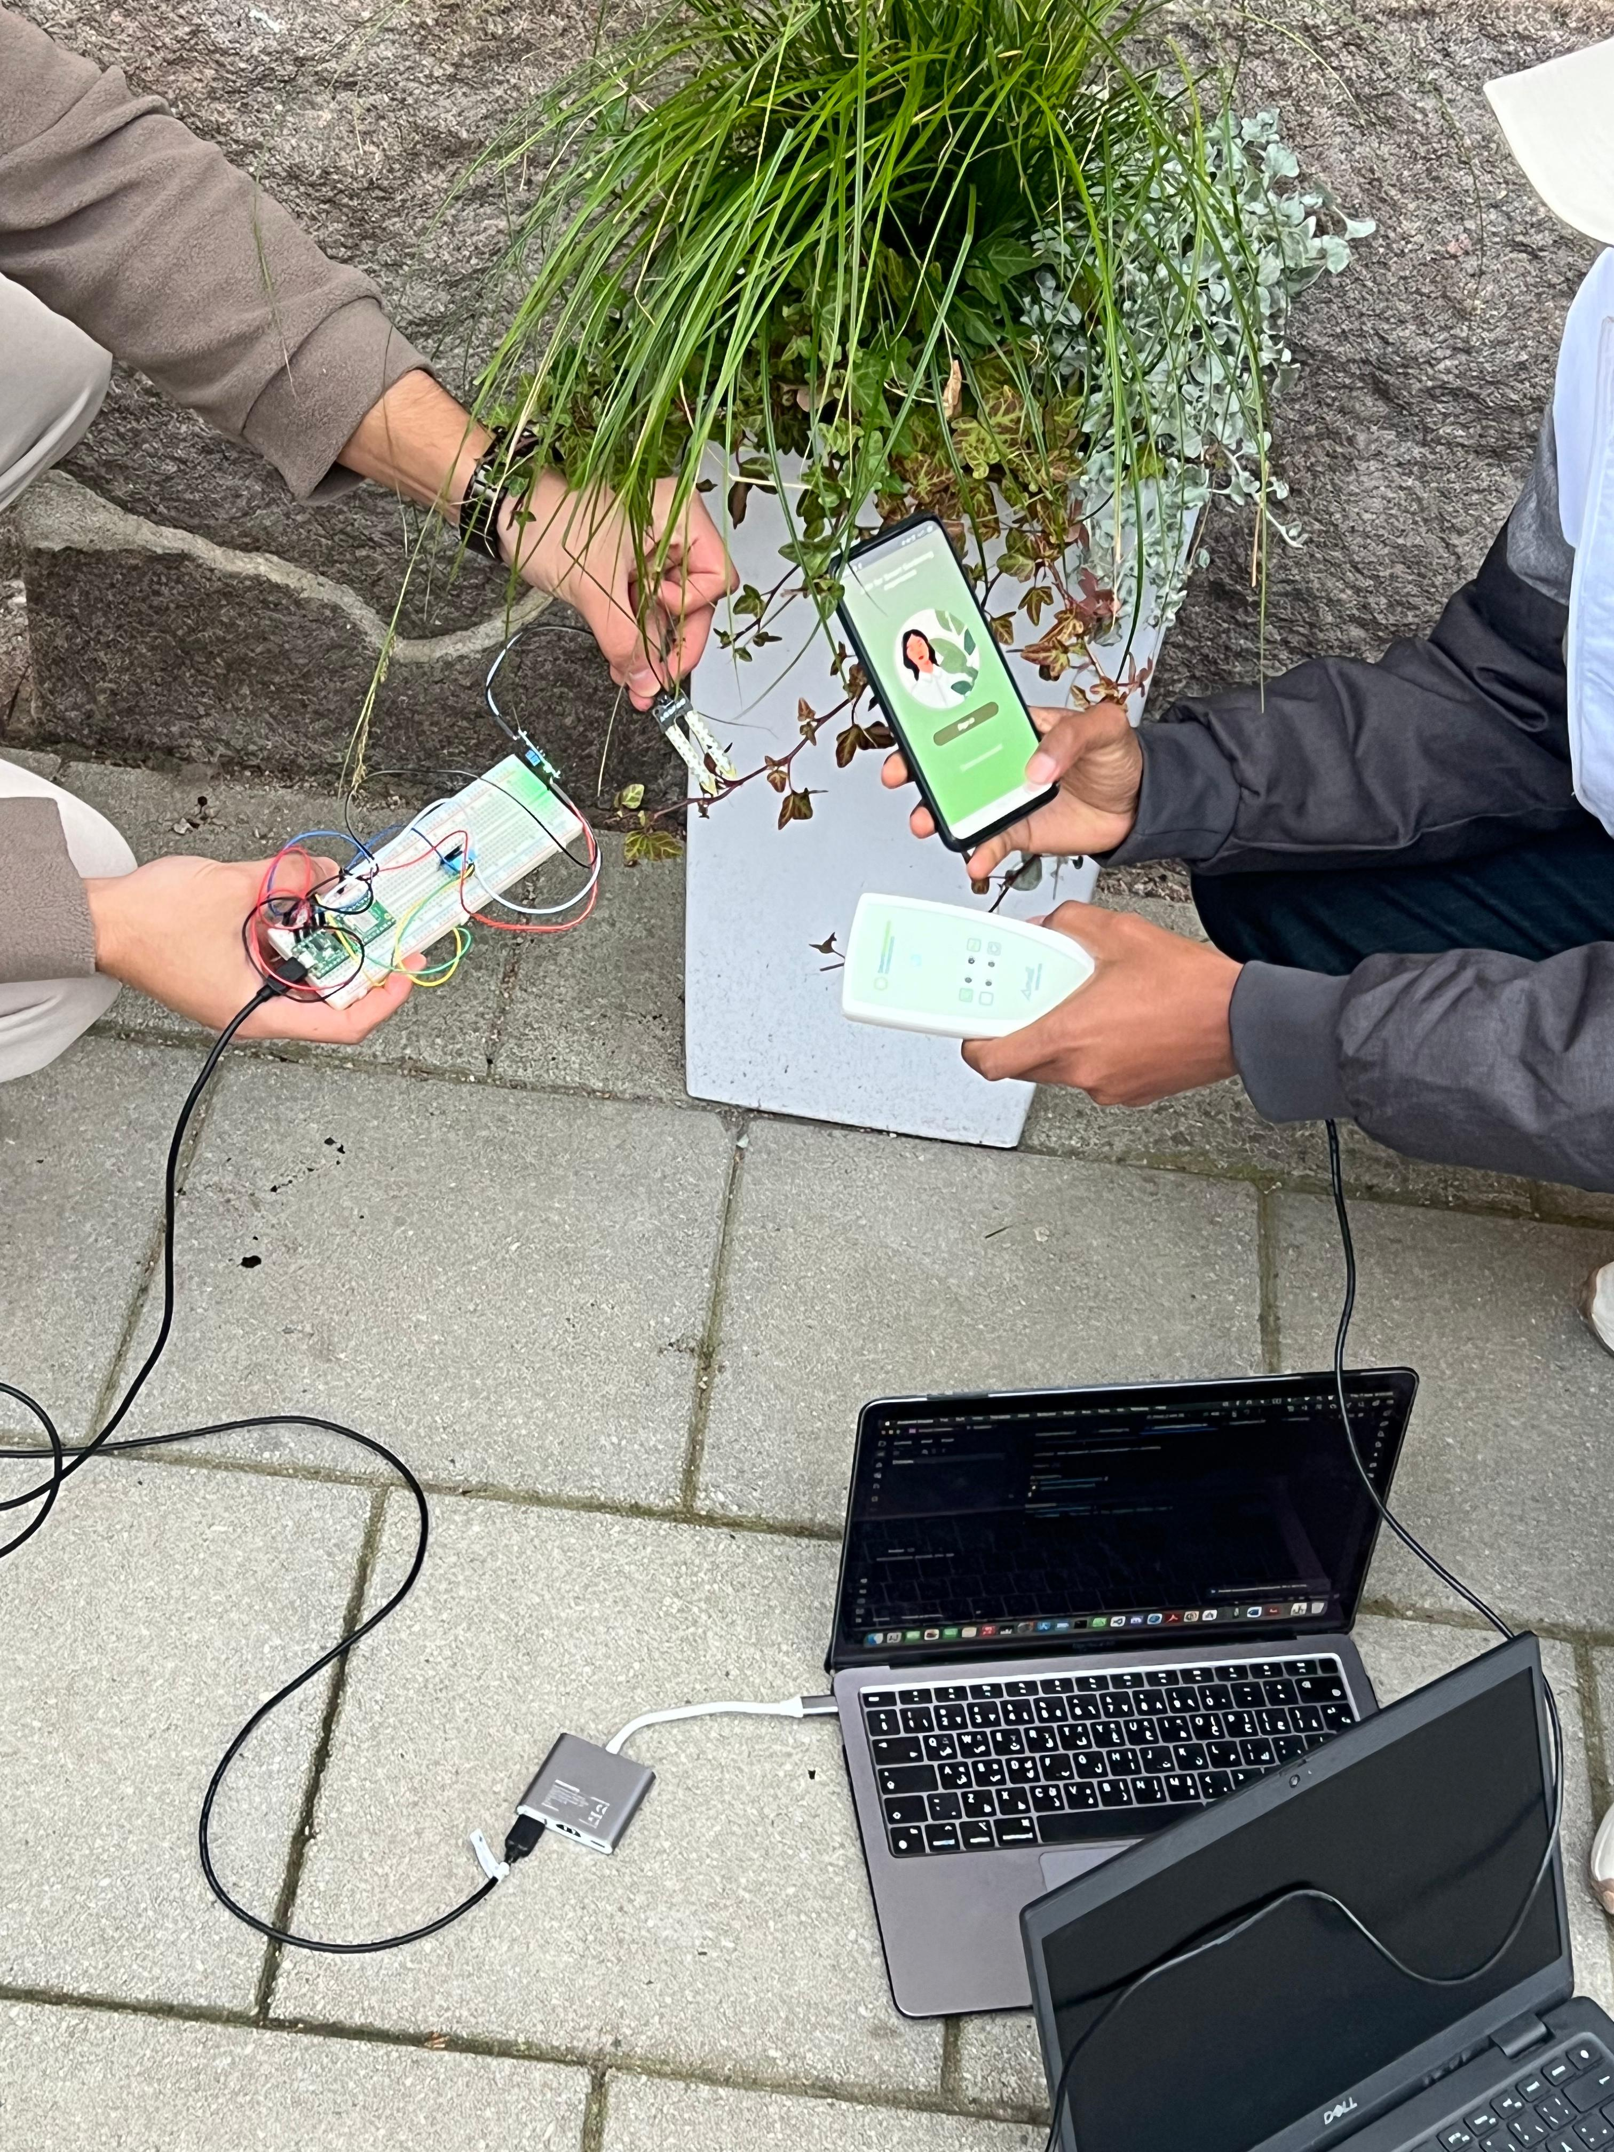
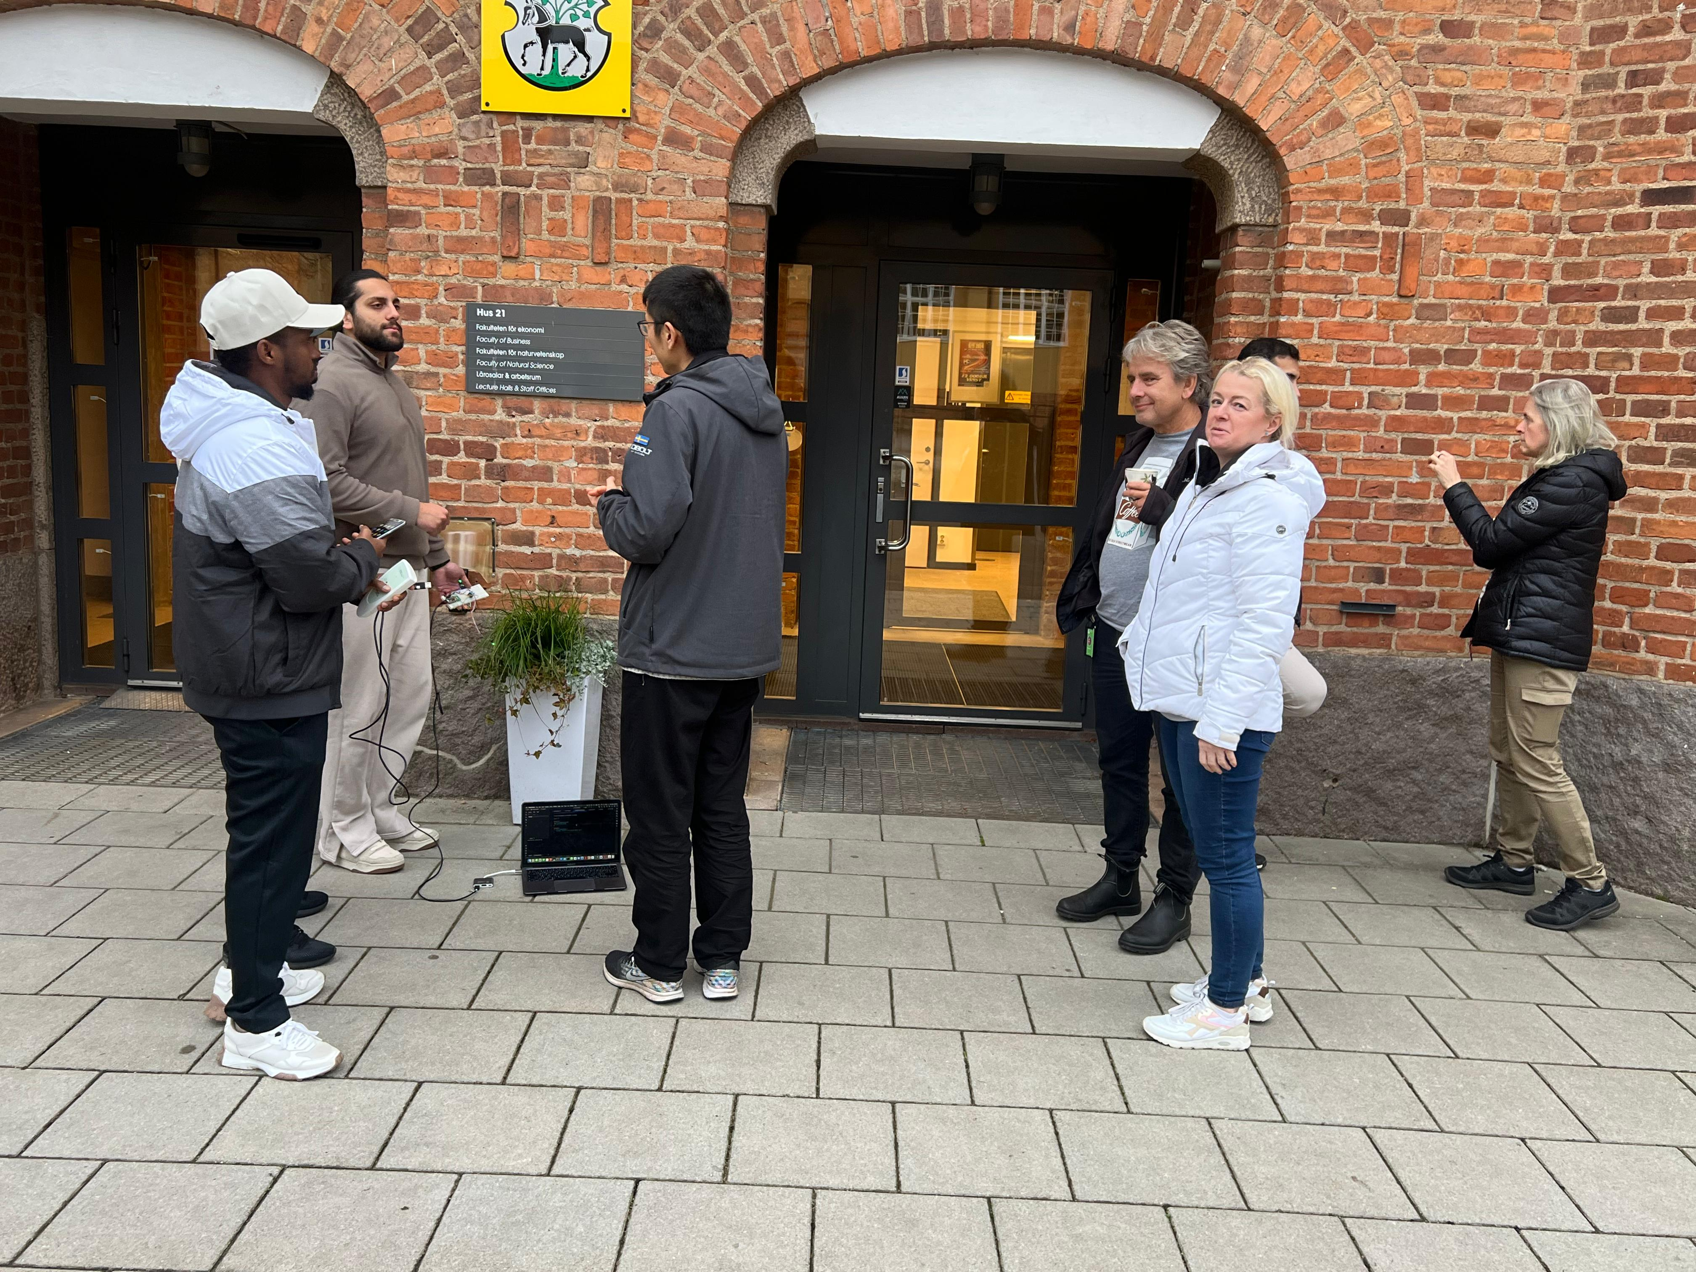
Setup Images
Notes:
Abshir

Slide 9
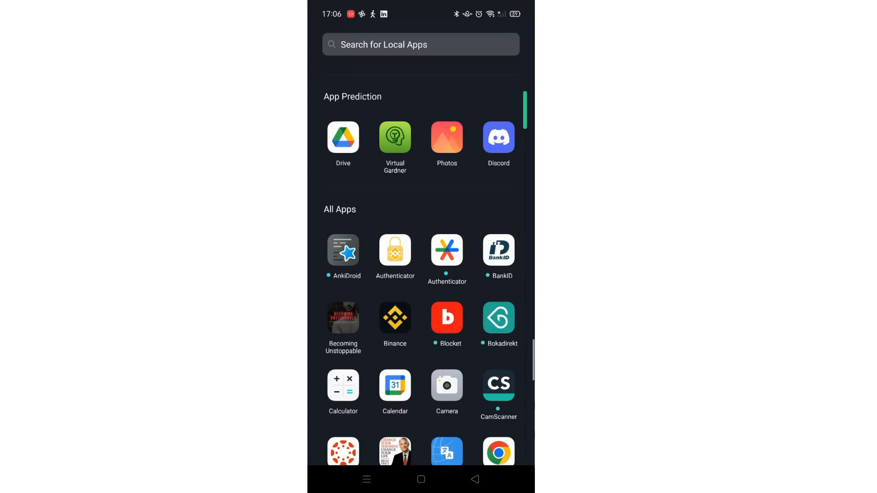
Demo
Video presentation!
Notes:
Abshir

Slide 10
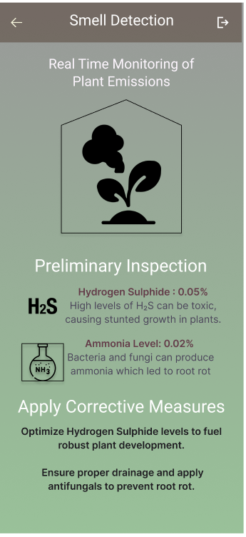
Future improvements
Implementing the machine learning models to recognize the smell and train the models for more smells.
Testing the Bluetooth connection with more recent APIs
UI/UX general improvements
Notes:
Solomon

Slide 11
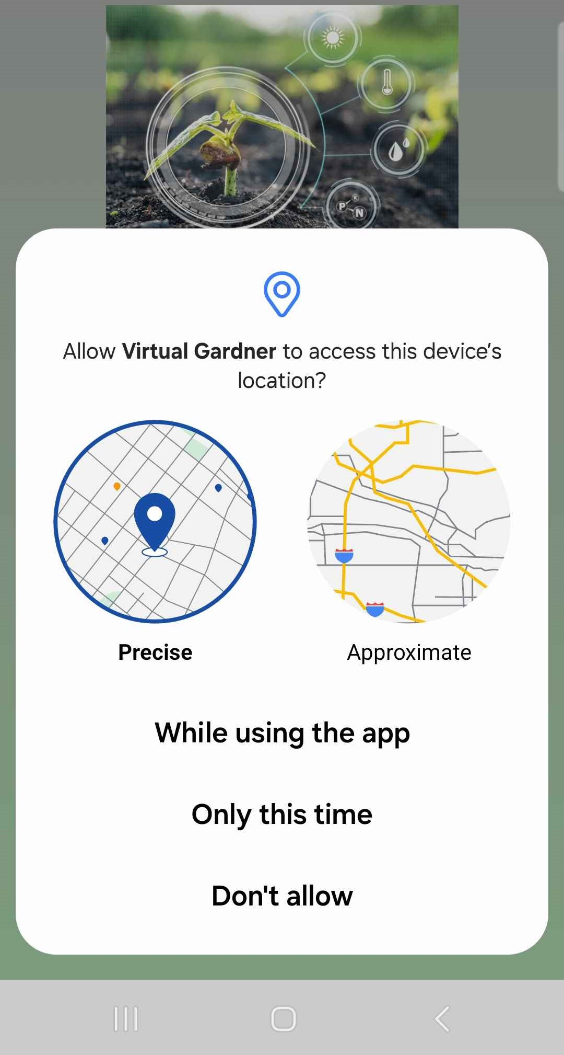
Feature Enhancement
Personalized Gardening Tips: The app will use user device’s location to provide localized gardening insights tailored to user’s area.
Location Choice: During the first prompt, you can select precise location.
Better Accuracy: Choosing precise location access ensures more accurate weather, soil, and climate advice for your plants.

Slide 12
Limitations
Time constraint
Accessing the machine learning models
Bluetooth connectivity (API 10)
Notes:
Alloush

Slide 13
Thank you.

